Slide 1
Determinant and Invers Matrix 3x3
Mathematics PowerPoint
TI 1I

Slide 2




Our Group
Al Azhar Rizqi Rifa’I Firdaus
Ichsan Ali Darmawan
Sri Kresna MahaDewa
Steven Christian Susanto
2241720263 / 01
2241720077 / 12
2241720244 / 24
2241720077 / 25

Slide 3
Table of Contents
Step by Step
Example
Check the Result

Slide 4
01
Step by Step

Slide 5
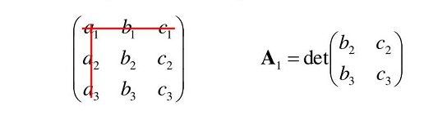
How to Inverting Matrix 3x3
1. Find the Cofactors
These are found by crossing out the row/column of an entry and calculating the 2x2 determinant created, and then finding the correct sign. For instance

Slide 6
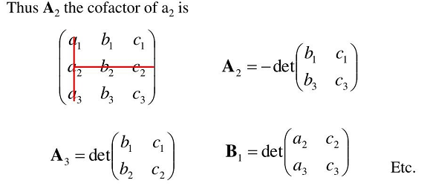
How to Inverting Matrix 3x3
1. Find the Cofactors

Slide 7
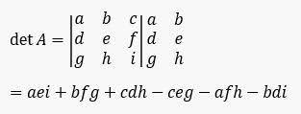
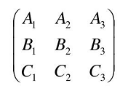
How to Inverting Matrix 3x3
2. Transpose the Matrix and Find the Determinant using minor Cofactors or Sarrus method
Transpose can be done by
swapping rows and column

Slide 8
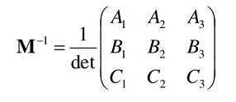
How to Inverting Matrix 3x3
3. Divide by the determinant
Combine the Step 1 and step 2 into one formula like such as

Slide 9
02
Example

Slide 10

Example
Find the Inverse of Following 3x3 Matrix
$$\left[\begin{matrix}2 & 1 & 1 \\ 1 & 1 & 1 \\ 1 & −1 & 2\end{matrix}\right]$$

Slide 11

Solution
1. Find the Determinant of the Matrix
$$\left[\begin{matrix}2 & 1 & 1 \\ 1 & 1 & 1 \\ 1 & −1 & 2\end{matrix}\right]$$
$$detA=\left(2×1×2\right)+\left(1×1×1\right)+\left(1×1×−1\right)− \left(1×1×1\right)−\left(2×1×−1\right)=4+1−1 −1−2+2=3$$

Slide 12






Solution
2. Find the Cofactor 1st Row
$$\left[\begin{matrix}1 & 1 \\ −1 & 2\end{matrix}\right]$$
$$\left[\begin{matrix}1 & 1 \\ 1 & 2\end{matrix}\right]$$
$$\left[\begin{matrix}1 & 1 \\ 1 & −1\end{matrix}\right]$$
$$Cofactor of 2 = + (3)= 3= 3= (2 + 1)= (2−(−1)) Minor of 2$$
$$Cofactor of 1 = (−1)= −1= 2= (2)= (2−1)Minor of 1$$
$$Cofactor of 1 = + (−2)= −2= −2= (−2)=(−1−1) Minor of 1$$

Slide 13






Solution
2. Find the Cofactor 2nd Row
$$\left[\begin{matrix}1 & 1 \\ 1 & −2\end{matrix}\right]$$
$$\left[\begin{matrix}2 & 1 \\ 1 & −2\end{matrix}\right]$$
$$\left[\begin{matrix}2 & 1 \\ 1 & −1\end{matrix}\right]$$
$$= −3Cofactor of 1 = − (−3)= −3= (−2−1)Minor of 1$$
$$Cofactor of 1 = − (−3)= −3= 3= (3)= (4 −1)Minor of 1$$
$$Cofactor of 1 = − (−3)= 3= −3= (−3)(−2−1)Minor of 1$$

Slide 14






Solution
2. Find the Cofactor 3rd Row
$$\left[\begin{matrix}1 & 1 \\ 1 & 1\end{matrix}\right]$$
$$\left[\begin{matrix}2 & 1 \\ 1 & 1\end{matrix}\right]$$
$$\left[\begin{matrix}2 & 1 \\ 1 & 1\end{matrix}\right]$$
$$Cofactor of 1 = + (0)= 0= 0 = (1−1)Minor of 1$$
$$Minor of −1$$
$$Cofactor of 2 = + (1)= 1= 1= (2−1)Minor of 2$$

Slide 15


Solution
2. Find the Cofactor
Cofactor Matrix
Adjoint / Transpose Matrix
$$\left[\begin{matrix}3 & −1 & −2 \\ −3 & 3 & 3 \\ 0 & −1 & 1\end{matrix}\right]$$
$$\left[\begin{matrix}3 & −3 & 0 \\ −1 & 3 & −1 \\ −2 & 3 & 1\end{matrix}\right]$$

Slide 16



Solution
3. Divide by Determinant
$$\left[\begin{matrix}1 & −1 & 0 \\ −\frac{1}{3} & 1 & −\frac{1}{3} \\ −\frac{2}{3} & 1 & \frac{1}{3}\end{matrix}\right]$$
$$\left[\begin{matrix}3 & −3 & 0 \\ −1 & 3 & −1 \\ −2 & 3 & 1\end{matrix}\right]$$
$$A^{−1}=\frac{1}{3}$$

Slide 17
03
Check the Result

Slide 18
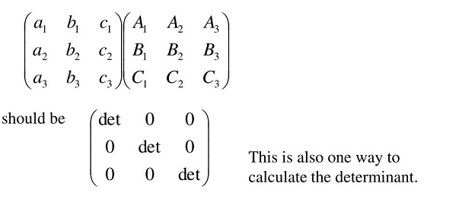
Checking
The method on the previous slide is very prone to errors, so in order to check the result. We can do as follows to evaluating our solution

Slide 19
Thanks

